Slide 1
MARKETING ANALYTICS I:
CREATING VALUE FOR
CUSTOMERS: VALUE IN USE
Professor Sonnier
Texas MSBA Program
Fall 2022

Slide 2
CONSUMER BEHAVIOR
A Model of The Decision Making Process
NEEDS TRIGGER
INFORMATION SEARCH
INFORMATION PROCESSING AND EVALUATION
Our attention today will be focused here.
PURCHASE DECISION
POST PURCHASE EVALUATION

Slide 3
MARKETING ANALYTICS
Types of Customer Value
Value in Use
Customer Value
Experiential Value
Functional Value

Slide 4
MARKETING ANALYTICS
Types of Customer Value
Value in Use
Customer Value
Experiential
Functional

Slide 5
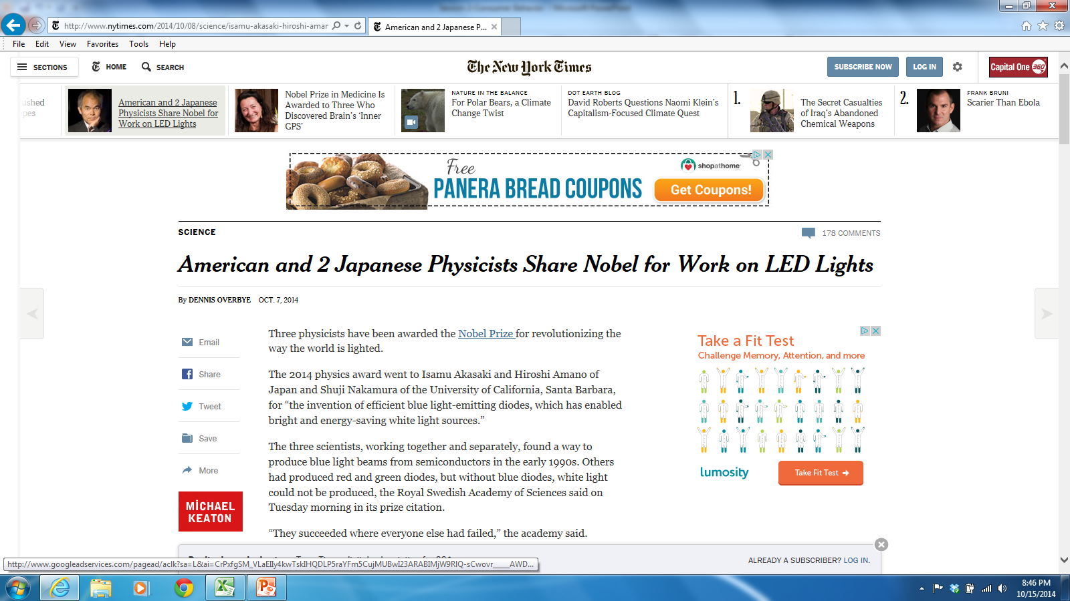
MARKETING ANALYTICS
Value in Use

Slide 6
MARKETING ANALYTICS
Value in Use
Value in Use for 50,000 hours of light
 | Incandescent | LED
Watts per Bulb | 60 | 10
kWh electricity (50K hrs.) | 3,000 | 500
Cost of electricity ($0.10/kWh) | $300 | $50
Bulb lifespan (hrs.) | 1,200 | 50,000
Bulbs needed (50K hrs.) | 42 | 1
Price per Bulb | $1.25 | ???
Total Costs for Bulbs | $52.50 | ???
Total Costs | $352.50 | ???
Value of New Tech + Cost to Operate New Tech = Cost to Own and Operate Existing Tech
Value of New Tech + $50= $352.50 so Value of New Tech = $302.50
Will the customer be willing to pay this?

Slide 7
MARKETING ANALYTICS
PPHMI: Record Label Economics
2.2 billion CD units sold over 30,000 releases implies average sales of ~75,000 units per release
2,500 albums released with a single

Slide 8
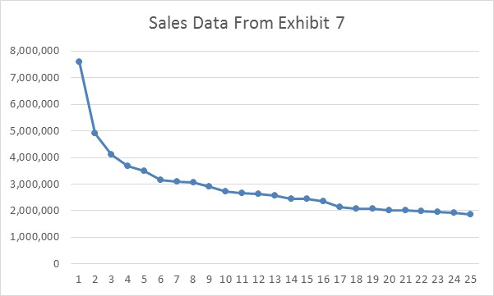
MARKETING ANALYTICS
PPHMI: Record Label Economics
Fewer than 15% of Released Titles are Profitable!
Only 10% of singles chart
Unit Sales
Rank
Average sales of 2002 Top 25 albums is 3MM units
65 albums sold over 1MM units
Having a Top 40 single is best indicator of profitability

Slide 9
POLYPHONIC HMI
Record Company Economics
What are total production and marketing costs?
What are the breakeven quantities on total production and marketing costs?

Slide 10
MARKETING ANALYTICS
PPHMI: Record Label Economics
Fewer than 15% of Released Titles are Profitable!
Margins are ~$4.60 per album

Slide 11
MARKETING ANALYTICS
PPHMI: Value in Use
Industry Situation
10% success rate
<15% of releases are profitable
Value
Probability of correct prediction: 80%
Can we quantify the value of Hit Song Science?

Slide 12
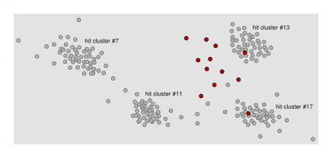
MARKETING ANALYTICS
Polyphonic HMI: The Basic Idea Behind Hit Song Science
Hit songs group into 50-60 clusters
Compare the mathematical properties of new songs to the properties of the hit clusters
If new song falls in a cluster it has a high chance of being a hit

Slide 13
MARKETING ANALYTICS
PPHMI: Value in Use
EVC Template (from Canvas Session 2 Folder)
?

Slide 14
MARKETING ANALYTICS
PPHMI: Value in Use
Label chooses it’s 100 albums to launch
How well does algorithm predict?
Launch only the 26 predicted hits: 18 false positives (Type I error)
Do not launch 74 predicted failures: 2 false negatives (Type II error)

Slide 15
POLYPHONIC HMI
Value Creation

Slide 16
MARKETING ANALYTICS
PPHMI: Value in Use
Wtd. Average

Slide 17
MARKETING ANALYTICS
PPHMI: Value in Use

Slide 18
POLYPHONIC HMI
Basic Company Economics
Are Polyphonic’s breakeven economics favorable or unfavorable?
Annual fixed costs are $500K
PPHMI costs are $300 for a 10 song album
Labels spend $3,000-$10,000 per song for research
Let’s assume labels currently test 3 songs per album
Price @ $30K: $500K/$29,700=17 album reports
Price @ $9K: $500K/$8,700=57 album reports

Slide 19
MARKETING ANALYTICS
PPHMI: Value in Use
Despite the value created by HSS, it was not widely adopted
Advantage (relative to status quo)
Compatibility (with existing systems)
Complexity (easy to understand)
Observable (benefits)
Risk (of failure)
Divisibility (Easy to try?)

Slide 20
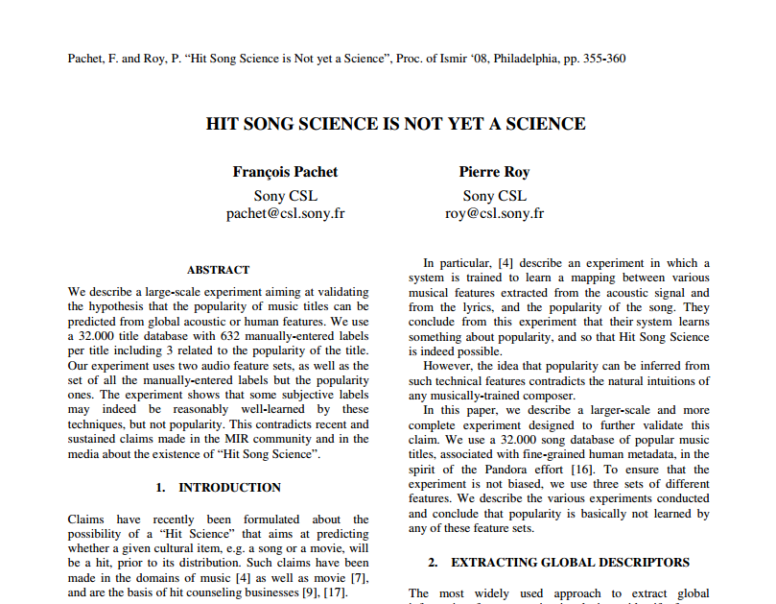
MARKETING ANALYTICS
Research from Sony Computer Science Labs

Slide 21
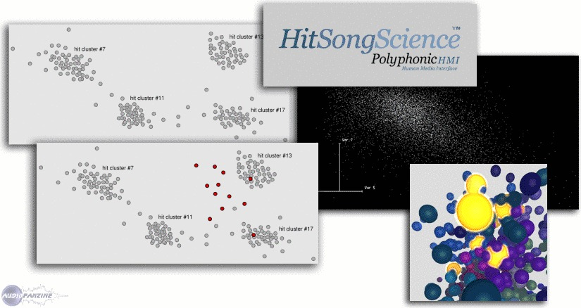

MARKETING ANALYTICS
Machine vs. Machine
versus

Slide 22

MARKETING ANALYTICS
Value in Use
What is the Value of a Hybrid Automobile?
Costs
Benefits

Slide 23

MARKETING ANALYTICS
Value in Use for the Toyota Prius
~50 MPG (city/hwy combined)
~30 MPG(city/hwy combined)
12,000 miles/50 mpg = 240 gal
12,000 miles/30 mpg = 400 gal
Annual fuel savings of 160 gal
@$2.00 per gal = $320 per year
@$4.00 per gal = $640 per year
~$25,000 MSRP
~$19,000 MSRP

Slide 24
MARKETING ANALYTICS
Value in Use
Prius Sales by Month
Download data file from Canvas (in Session 2 Folder)
For now use the data in the sales-gas tab
What is the effect of a $1 increase in gas prices on monthly sales?

Slide 25
MARKETING ANALYTICS
Value in Use
What Effect Do Gas Prices Have on Prius Sales?
What do we learn from this simple linear model?

Slide 26
MARKETING ANALYTICS
Value in Use
Are Gas Prices Affecting Prius Sales?
Linear Regression
The marginal effect is the unit change in sales given a unit change in gas prices
For the linear regression model the marginal effect of a change in gas prices is constant (i.e., it is the same everywhere along the line)

Slide 27
MARKETING ANALYTICS
Value in Use
What is the Elasticity of Sales with respect to Gas Price?
For the linear regression model the elasticity depends on which sales-price pair you choose (i.e., where you are located on the line matters!)

Slide 28
MARKETING ANALYTICS
Value in Use
What Effect Do Gas Prices Have on Prius Sales?
A 10% increase in gas prices yields a 33% increase in monthly Prius sales

Slide 29
MARKETING ANALYTICS
Value in Use
What Effect Do Gas Prices Have on Prius Sales?
Linear Regression
Marginal Effect of Gas Prices on Sales
Elasticity of Sales with respect to Gas Prices

Slide 30
MARKETING ANALYTICS
Value in Use
Let’s Consider Some Nonlinear Equations
Equation
Marginal Effect*
*Marginal Effect refers to the unit change in y given a unit change in x

Slide 31
MARKETING ANALYTICS
Value in Use
What Effect Do Gas Prices Have on Prius Sales?
Log-Log Model
Marginal Effect of Gas Prices on Sales
Elasticity of Sales with respect to Gas Prices

Slide 32
MARKETING ANALYTICS
Value in Use
What Effect Do Gas Prices Have on Prius Sales?
Marginal Effect of Gas Prices on Sales
In the Log-Log model the marginal effect of gas prices on sales depends on which sales-price pair you choose (i.e., the marginal effect depends on where you are located on the curve)

Slide 33
MARKETING ANALYTICS
Value in Use
What is the Elasticity of Sales with respect to Gas Price?
For the Log-Log Model
Elasticity of Sales with respect to Gas Prices
In the Log-Log model the elasticity of sales with respect to gas prices is constant (i.e., it does not matter where you are along the curve). It is given by the beta coefficient from the regression.

Slide 34
MARKETING ANALYTICS
Value in Use
For the Log-Log Model
Marginal Effect of Gas Prices on Sales
Elasticity of Sales with respect to Gas Prices
In the Log-Log model the elasticity of sales with respect to gas prices is constant (i.e., it does not matter where you are along the curve). It is given by the beta coefficient from the regression.

Slide 35
MARKETING ANALYTICS
Value in Use
We have two models
Log-Log Model
Linear Model
Which model do we prefer?
Log-Log Model
Linear Model

Slide 36
MARKETING ANALYTICS
Value in Use
What Effect Do Gas Prices Have on Prius Sales?
Linear Regression
Marginal Effect of Gas Prices on Sales
Elasticity of Sales with respect to Gas Prices

Slide 37
MARKETING ANALYTICS
Value in Use
What Effect Do Gas Prices Have on Prius Sales?
What else to consider?
Seasonality?
Dynamic Effects?
Marketing Mix Effects?
Other Factors?

Slide 38
MARKETING ANALYTICS
Prius Value
How Does Prius fare in the ACCORD framework?
Advantage (relative to status quo)
Compatibility (with existing systems)
Complexity (easy to understand)
Observable (benefits)
Risk (of failure)
Divisibility (Easy to try?)

Slide 39
MARKETING ANALYTICS
Key Concepts from Today
Consumers derive value from goods and services in different ways
Value in Use
Functional Value
Experiential Value
Value is Use is the value consumers derive from using a good or service relative to the status quo
Value is Use is not generally equal to the price a firm may charge
Competition
Other dimensions of value
Other dimensions of consumer behavior
Creating value in use is not the only determinant of new product adoption
ACCORD

Slide 40
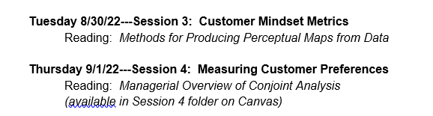
MARKETING ANALYTICS I
Next Week in Marketing Analytics

